Slide 1
Polish charity collecting donations for the sick.

Slide 2
Founder
The founder of this foundation is Patryk Urban.

Slide 3
How many years has it been in existence?
The organization has been operating since 2009 until today.

Slide 4
The beginnings
He took 60,000 to create the platform PLN a consumer loan, and the missing amount was collected from friends. For the first 4 years, the website generated losses until it was forced to look for other sources of income. It was then that he handed over the management of the website to his wife. Created 8 years ago, the platform today has over 124 million PLN paid by 750,000 Internet users. the founder himself says that this is not a commercial activity. Only that it is worth helping others because it is not known when maybe we will have such a need.

Slide 5
What does the organization do siepomaga (ang. organization helps)?
Their goal is to raise funds through fundraisers organized on social media with the help of social networks.
We promote the use of modern technologies in the conduct of activities of public benefit organizations.

Slide 6
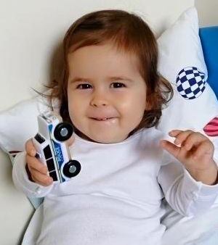
Recent activity
This is an advertisement for a 19-month-old girl named Nina. He is struggling with quite unusual SMA disease - spinal muscle atrophy. the goal of this organization is gene therapy in the fight against SMA and rehabilitation. has already been supported by 8686 people, and PLN 9,303,861 is still missing. The amount is constantly growing, but there is not much time to collect such a large amount, because the collection ends on March 30, 2021. It is really only 3 months.

Slide 7
The most people who get sick and whom people help are small children. It is really very sad that is why such organizations are very much needed.
There are many influencers on social networks, such as Instagram, who encourage us to support them. It is really a very nice solution to support those in need.

Slide 8
Summarizing
The beginnings were not easy, as we could read on the slide, but it was worth it, because this foundation helped many people. It is not much, because it is enough to support and pay even PLN 1. It is worth supporting, because it is not known whether we will ever need such a need.

Slide 9
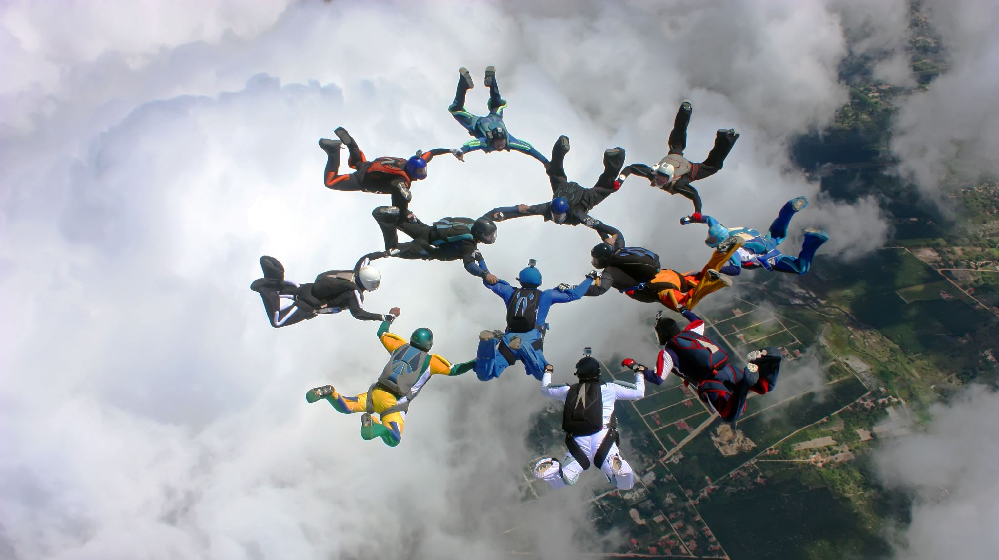
Thank you for your attention!
Borkowska Dominika kl. II LO pp nr. 3

